Slide 1
Recommendation Engine
Group 4

Slide 2
Q1
What is the purpose of the recommendation engine ?

Slide 3
Offer customized recommendation tailored to customers’ taste
Use past behavior of existing customers to recommend products
Capture more customers/ Retention
Increase sale value and volume

Slide 4
Q6
How to use matrix factorization in recommendation engine ?

Slide 5
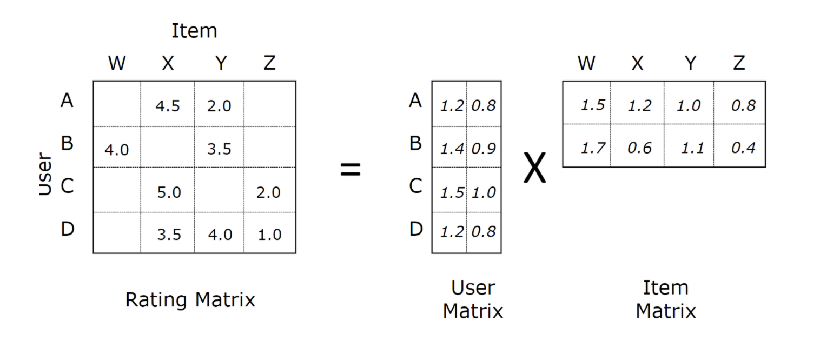
Notes:
One strength of matrix factorization is the fact that it can incorporate implicit feedback, information that are not directly given but can be derived by analyzing user behavior. Using this strength we can estimate if a user is going to like a movie that (he/she) never saw. And if that estimated rating is high, we can recommend that movie to the user.

Slide 6
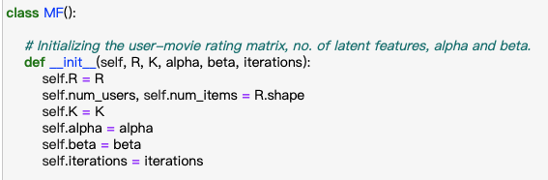
R – The user-movie rating matrix
K – Number of latent features
alpha – Learning rate for stochastic gradient descent
beta – Regularization parameter for bias
iterations – Number of iterations to perform stochastic gradient descent
Notes:
R – The user-movie rating matrix
K – Number of latent features
alpha – Learning rate for stochastic gradient descent
beta – Regularization parameter for bias
iterations – Number of iterations to perform stochastic gradient descent

Slide 7
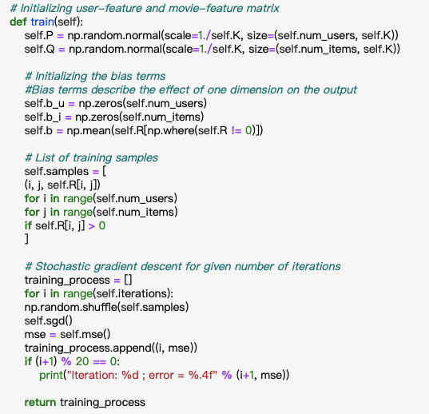
Notes:
The point of integrating bias terms is to remove the "bias" given by users (or the bias for a movie) : for example if Alice tends to rate all movies 1 star too high, in order to compare her ratings to other users, you must remove 1 star to all of her ratings. Similarly, if you want to predict the rating Alice will give to a movie, you have to add 1 star to the score you would get if Alice was an "average" user.

Slide 8
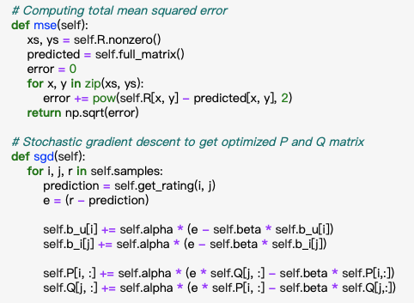

Slide 9
